Slide 1
MC3 Schedule Builder

Slide 2
CIS 112 Data Structures
MAT 165 Discrete Mathematics
Major
English
Requirements
Mathematics
Chemistry
Computer Science
Nursing
Electives
Mathematics
Biology
Physics
Computer Science

Slide 3
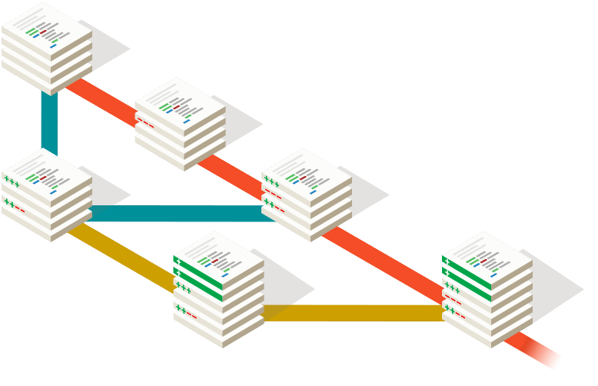



Tools!

Slide 4
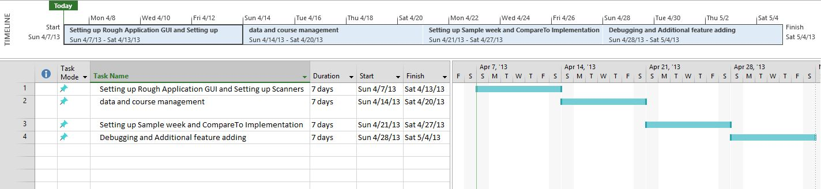
Time Line

Slide 5
Responsibilities
Sage | Matty D | Richard
Documentation GUI design and implementation RateMP input Troubleshooter | Project Manager Lead programmer File Management Facebook Integration | Data Management Food Director Additional Features

